Slide 1
The Importance of Invasive Species
Amanda Hodges, Ph.D.
Entomology/Nematology Dept.
University of Florida
Exotic Species & Biosecurity Issues ALS 4161/6166

Slide 2
Objectives
Understand Terminology.
Be Familiar with Historical Case Study Examples.

Slide 3
Case Studies: Key Concepts
How did the pest arrive?
Is this still a possible pathway for an invasive species today?
How was the problem solved and what did we learn?
What was the cost of invasion?

Slide 4
Introductory Terminology
Invasive: a pest that is adversely affecting the environment or an agricultural commodity.

Slide 5
Introductory Terminology
Exotic: a species not known to originate from a given geographical region.

Slide 6
Introductory Terminology
Pest: any animal, disease, plant, or other organism that is damaging an agricultural commodity, urban environment, or natural area.

Slide 7
Introductory Terminology
Limited Distribution: refers to an organism that is not native or widely distributed in its new environment.

Slide 8
Introductory Terminology
Eradication: removal of an introduced exotic pest from its newly established geographical distribution.

Slide 9
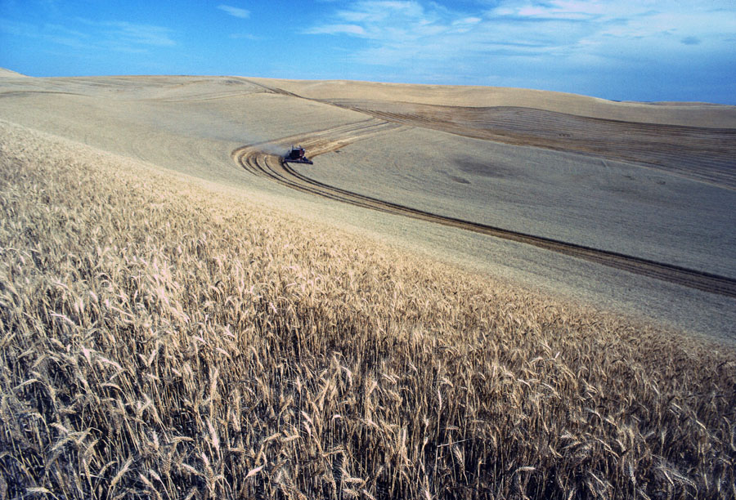
Exotic, Not Invasive
USDA-ARS Photo Gallery http://www.ars.gov/

Slide 10
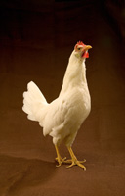
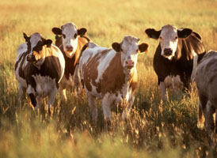
Exotic, Not Invasive
USDA-ARS Photo Gallery http://www.ars.gov/

Slide 11
Early Spread of Invasive Species
Pests moved west to California with new agricultural crops in the 1800’s.
Human travel also affected pest movement.

Slide 12
Case Study Examples
Cottony cushion scale
Powdery mildew
Grape phylloxera
Purple Loosestrife
Indian Mongoose

Slide 13
Cottony Cushion Scale
Photo Credits: Sturgis McKeever, Georgia Southern University, http://www.forestryimages.org/ Image No. 1482005

Slide 14
Cottony Cushion Scale
When? 1868
Where? California
What? Lemon from Australia
Photo Credit: Adré Kaowatha, German Wikipedia administrator http://en.wikipedia.org/wiki/File:Lemon.jpg

Slide 15
Solutions?

Slide 16
Try Tested Options: San Jose Scale, Quadraspidiotus perniciosus
Photo Credits: Eugene Nelson, Colorado State University
http://www.forestryimages.org/ Image No. 5360549

Slide 17
The Answer: Foreign Exploration
The People
C.V. Riley, USDA
Norman Colman, California Commission of Agriculture
Albert Koeble, 1888 International Exposition in Melbourne

Slide 18
Cottony Cushion Scale
Found: Vedalia ladybird beetle, Rodolia cardinalis
When? October 15, 1888
Koeble shipped live beetles to USDA scientist Coquillet
1889 beetles released to growers

Slide 19
Outcomes
Orange shipments tripled from Los Angeles County in one year.
Program Costs: thousands of dollars
Estimated Savings: millions of dollars.
University of Florida IFAS Information and Communications Photo Gallery http://ics.ifas.ufl.edu/pictures/
Image No. 00039S

Slide 20
Powdery Mildew, Erysiphe necator
Photo Credit: University of California Regents, Image available at:
http://www.winesandvines.com/template.cfm?section=features&content=58955

Slide 21
Powdery Mildew
Native to the eastern U.S.
Native North American vines had some resistance to powdery mildew and other diseases.
Photo Credit: William Brown, Colorado State University, powdery mildew on wine grapes. http://www.forestryimages.org/ Image No. 5356661

Slide 22
Powdery Mildew
England 1845: First European Report
1850’s: Europe, Asia Minor, and North Africa
Tony Hassall, Queensland Government Website,Infected Chardonnay grape vine leaves Image available at:
http://dpi.qld.gov.au/cps/rde/dpi/hs.xsl/26_6192_ENA_HTML.htm

Slide 23
Powdery Mildew
50-90% Crop Losses
Starvation, Emigration from Madeira, Spain
Railroad Tracks in Italy Destroyed

Slide 24
Powdery Mildew
Who?
Versailles: A.M. Grison and Pierre Ducharte
Paris: J.H. Léveillé
England: Reverend M.J. Berkeley and E. Tucker
Venice: Giovanni Zanardini
Pathogen biology was studied and sulfur-based solutions were used to spray for powdery mildew. Sulfur solutions available in the 1860s.

Slide 25
Grape Phylloxera, Daktulosophaira vitifoliae
Photo Credit: Whitney Colorado State University,
http://www.forestryimages.org/ Image No. 5083002

Slide 26
Grape Phylloxera
Europe: 1863
California: 1870’s
Weakens and kills host by feeding on roots.
Root damage from grape phylloxera
Photo Credit: Jack Kell Clark, University of California Regents, UC Statewide IPM Project http://www.ipm.ucdavis.edu/PMG/D/I-HO-DVIT-CD.004.html

Slide 27
The Solution?

Slide 28
The Solution
Replant vineyards with Eastern U.S. phylloxera-resistant rootstock.
People
C.V. Riley, Illinois and Missouri
Eugene Hilgard, California
George Husmann, Missouri and California

Slide 29
Purple Loosestrife, Lythrum salicaria
Photo Credit: Barry Rice, sarracenia.com
http://www.forestryimages.org/ Image No. 5391680

Slide 30
Purple Loosestrife
Introduced in the 19th Century
~115,000 hectares per year newly infested
Changing wetland habitats
Photo Credit: John M. Randall, The Nature Conservancy
http://www.forestryimages.org/ Image No. 5392329

Slide 31
Purple Loosestrife
Habitat loss threatens 44 native plants and animals.
Occurs nationwide.
~$45 million/year in management and forage losses
Photo Credit: Bog Turtle, Clemmys muhlenbengil, United States Army Corps of Engineers, Wikipedia http://en.wikipedia.org/wiki/File:Bog_Turtle.jpg

Slide 32
Indian Mongoose, Herpestes aurpunctatus
Photo Located at: http://www.hawar-islands.com/blog/index.php/2007/12/02/friday_30th_november

Slide 33
Indian Mongoose
Introduced in the 1800’s for the biological control of rats in sugarcane.
Jamaica, Puerto Rico, West Indian Islands, and Hawaii
Posted on the USDA Forest Service Website, http://www.fs.fed.us/r8/caribbean/wildlife-facts/2002/wildlife-facts-august-2002.shtml originally obtained from animal photos archives.

Slide 34
Indian Mongoose
Mongoose controlled Asiatic, but not European rat
Fed on native, ground-nesting birds as well as amphibians and reptiles
Photo: European rat, http://www.ew.govt.nz/Environmental-information/Plant-and-animal-pests/Animal-pests/Rats-and-feral-cats/

Slide 35
Indian Mongoose
Vector of rabies and leptospirosis in Puerto Rico and other Caribbean Islands
~$50 million estimated annual damages in Hawaii and Puerto Rico

Slide 36
References
Hayes, K.R., and S.C. Barry 2008. Are there any consistent predictors of invasion success? Biol. Invasions. 10: 483-506.
Olson, L.J. 2006. The economics of terrestrial invasive species: A review of the literature. Agricultural and resource economics review. 178-194.
Pimental, D., L. Lach, R. Zuniga, and D. Morrison. 2000. Environmental and economic costs of nonindigenous species in the U.S. BioScience. 50: 53-65.
Iranzo, S., A.L. Olmstead, and P.W. Rhode. 2003. Historical perspectives on exotic pests and diseases in California. in Exotic pests and diseases: biology and economics of biosecurity. Sumner, D.A. (ed.).

Slide 37
Required Readings
ALS 4161 and 6166
Pimental, D., L. Lach, R. Zuniga, and D. Morrison. 2000. Environmental and economic costs of nonindigenous species in the U.S. BioScience. 50: 53-65.
ALS 6166 Only
Olson, L.J. 2006. The economics of terrestrial invasive species: A review of the literature. Agricultural and resource economics review. 178-194.

Slide 38
Class Discussion Topics
Federal and/or state governments should strictly regulate all organisms that threaten agricultural and natural areas.
Federal and/or state governments should not regulate University researchers. Their education and experience precludes them from making any mistakes regarding the accidental release of invasive species.
Federal and/or state governments should have regulations, permits, and requirements, but should also work towards an improved public outreach effort to support awareness regarding exotic, invasive species.

